Slide 1
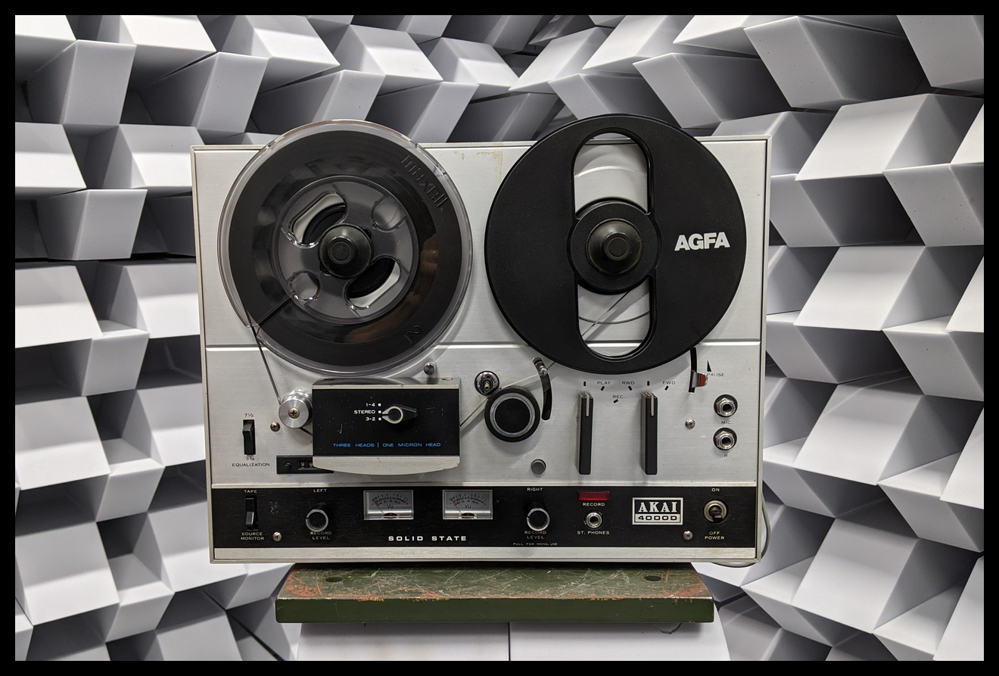
Neural Modeling of Magnetic Tape Recorders
Otto Mikkonen, Alec Wright, Eloi Moliner, & Vesa Välimäki
7th September 2023

Slide 2
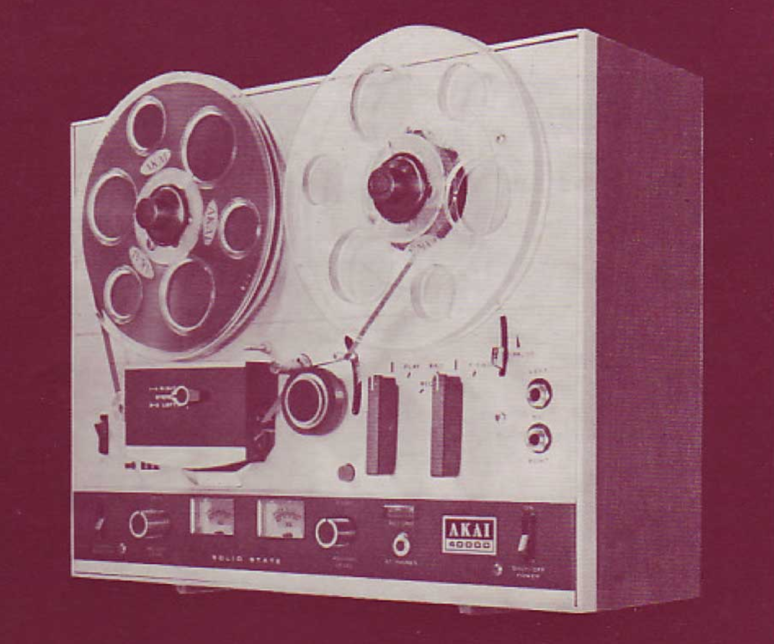
Outline
Magnetic Recording
Proposed Method
Modeling
Training
Experiments
Conclusions
Akai 4000D reel-to-reel recorder
© Akai Corp.
Notes:
30sec

Slide 3
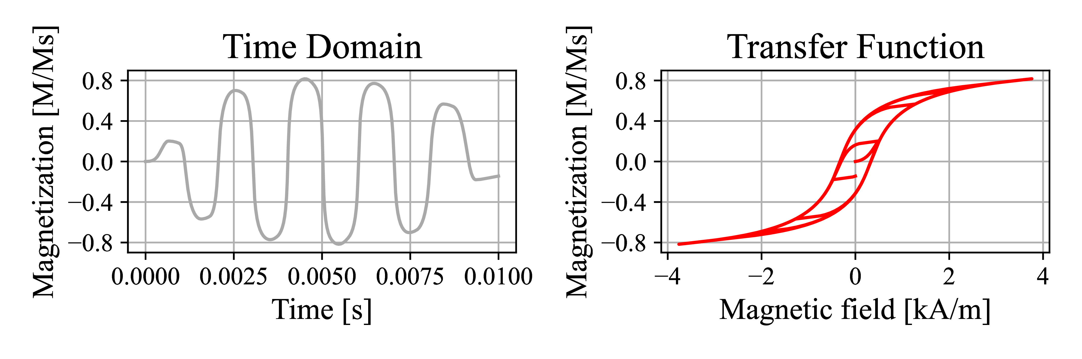
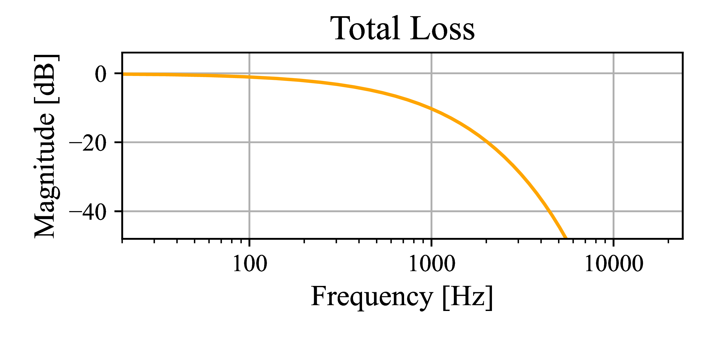
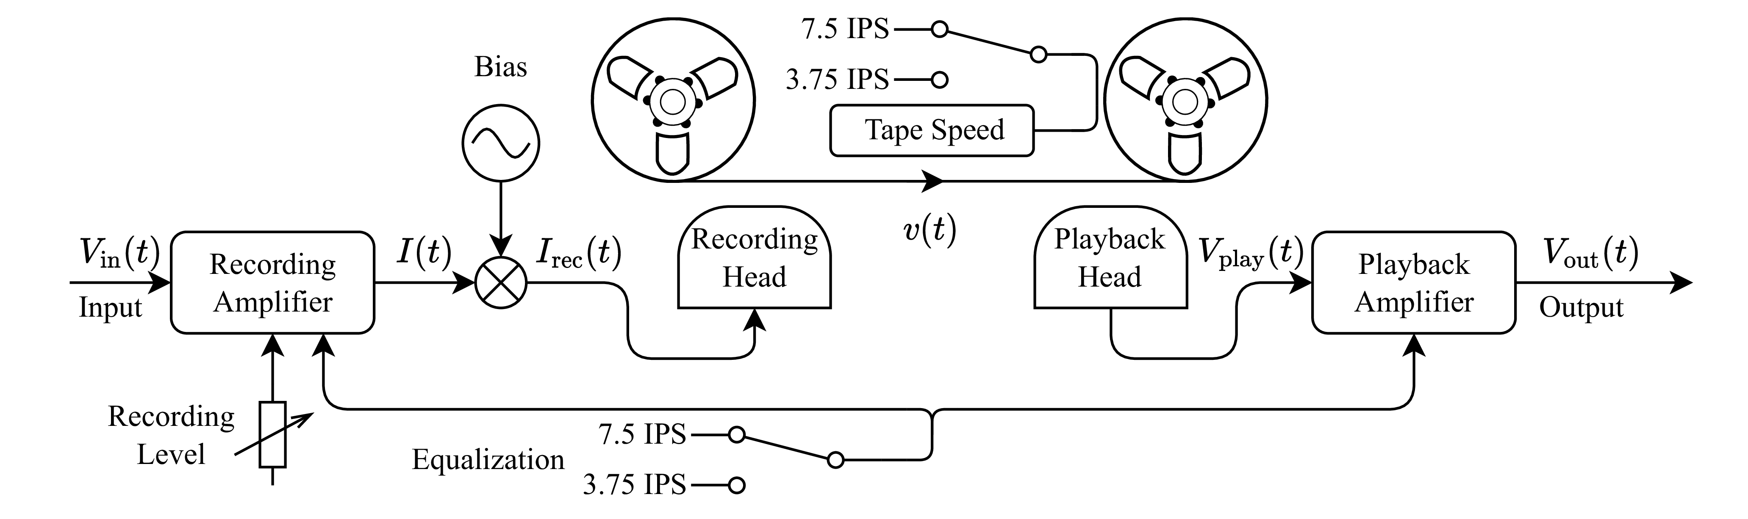

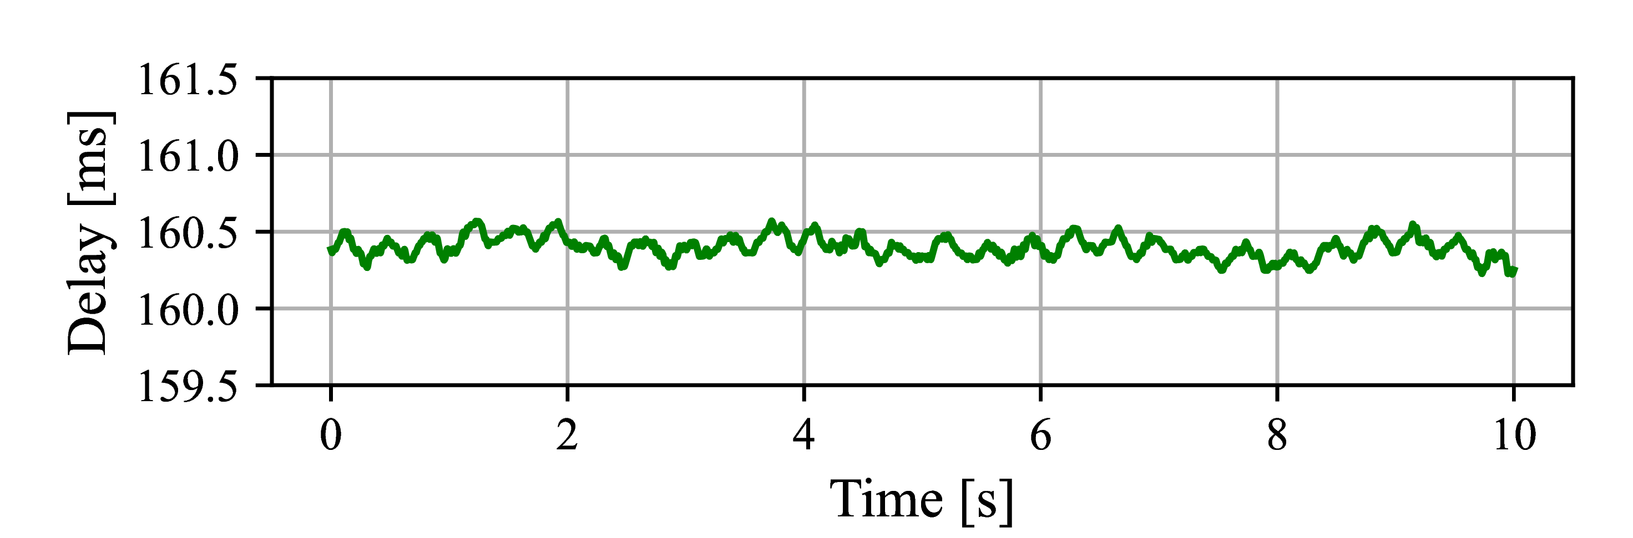
Magnetic Recording
Playback Loss
Head-to-Head Delay
Notes:
1min - 1min30sec

Slide 4
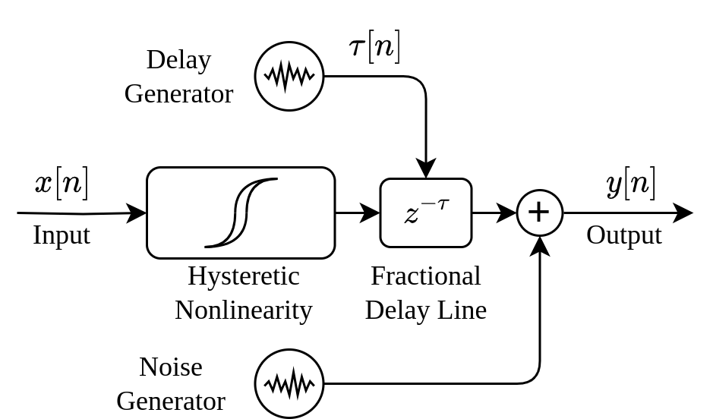
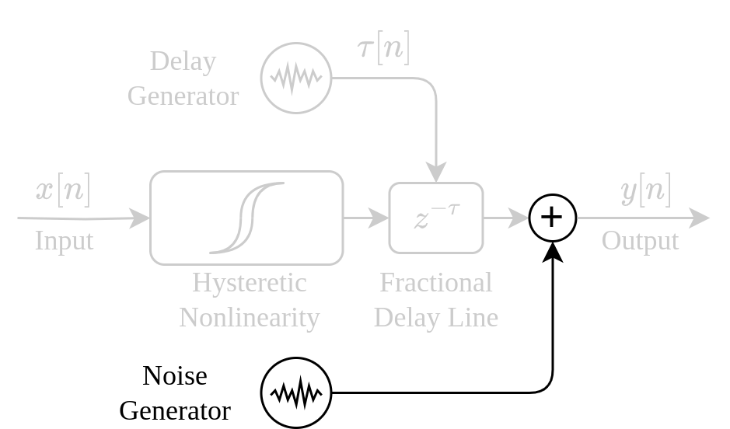
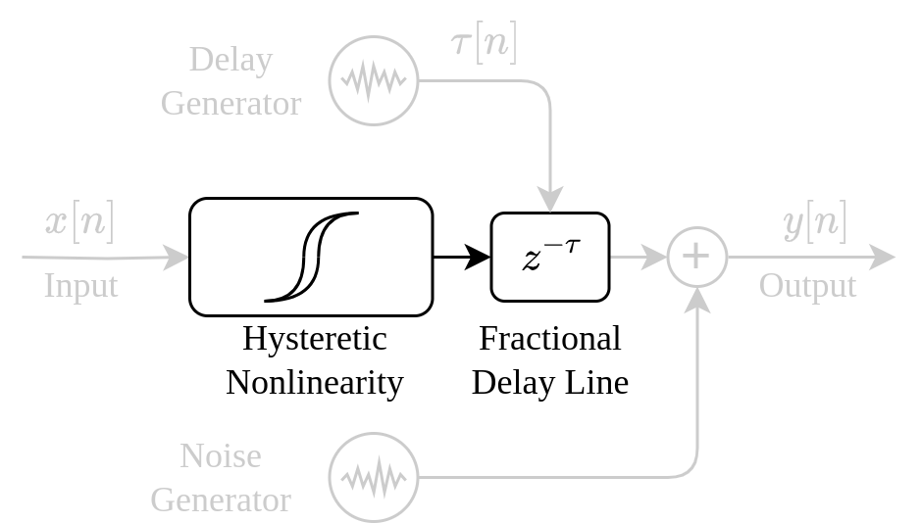
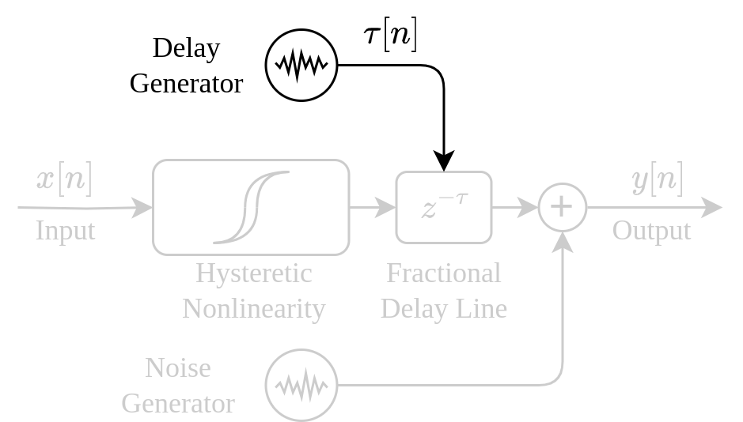
Proposed Grey-Box Model
”Recording Path” (Nonlinearity + Delay Line)
Delay Generator
Noise Generator
Notes:
30sec – 2min

Slide 5
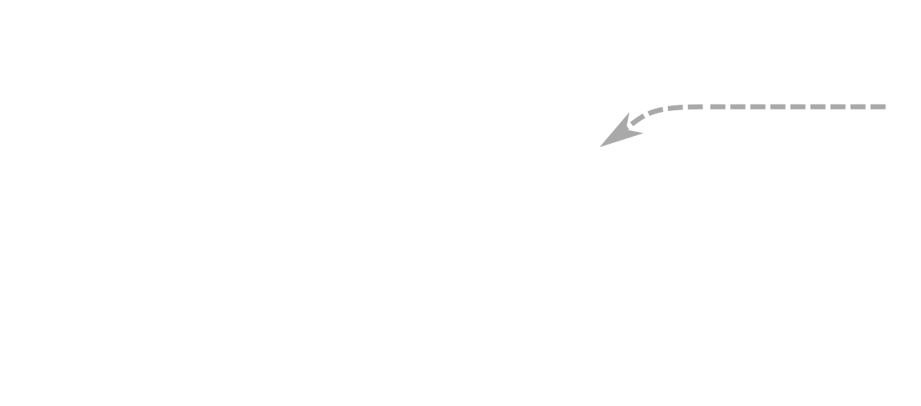
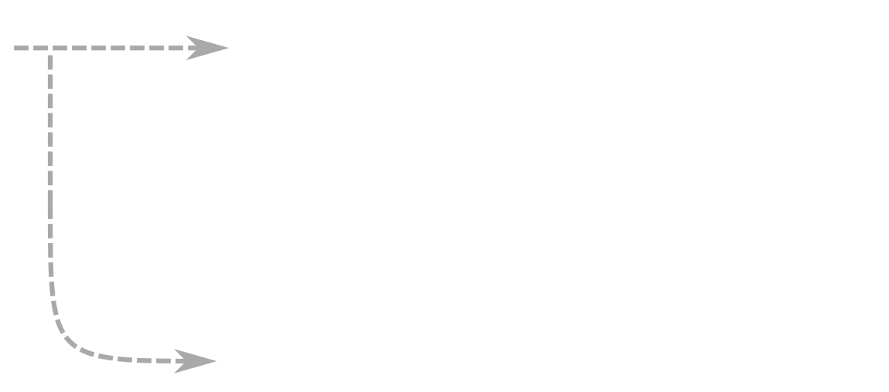
Proposed Grey-Box Model
Diffusion Models
Differentiable
Recurrent Neural Network
Wright, et al. “Real-Time Black-Box Modelling with Recurrent Neural Networks.” In Proc DAFX, 2019.
Engel, et al. “DDSP: Differentiable Digital Signal Processing.” In Proc. ICLR, 2020.
Moliner, et al. “Realistic Gramophone Noise Synthesis Using a Diffusion Model.” In Proc. DAFX, 2022
Notes:
30sec - 2min30sec

Slide 6
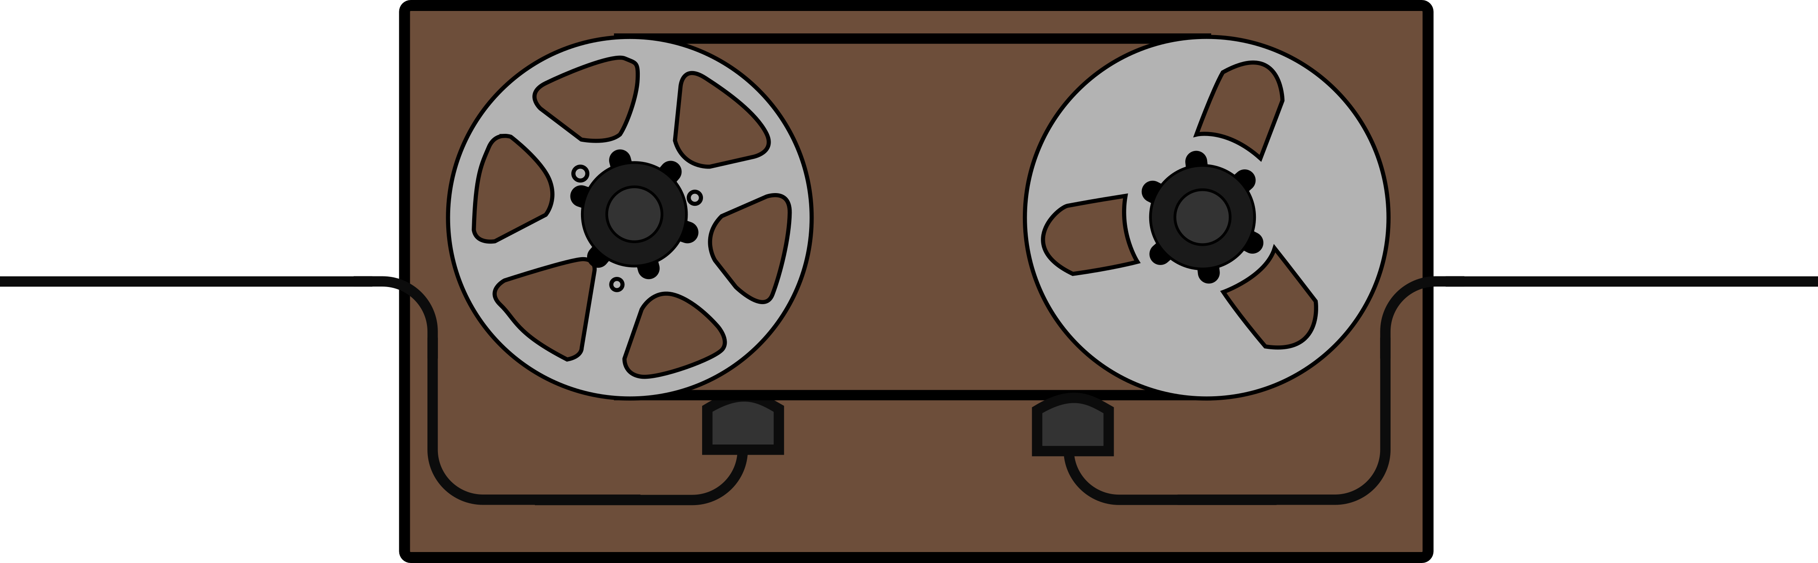
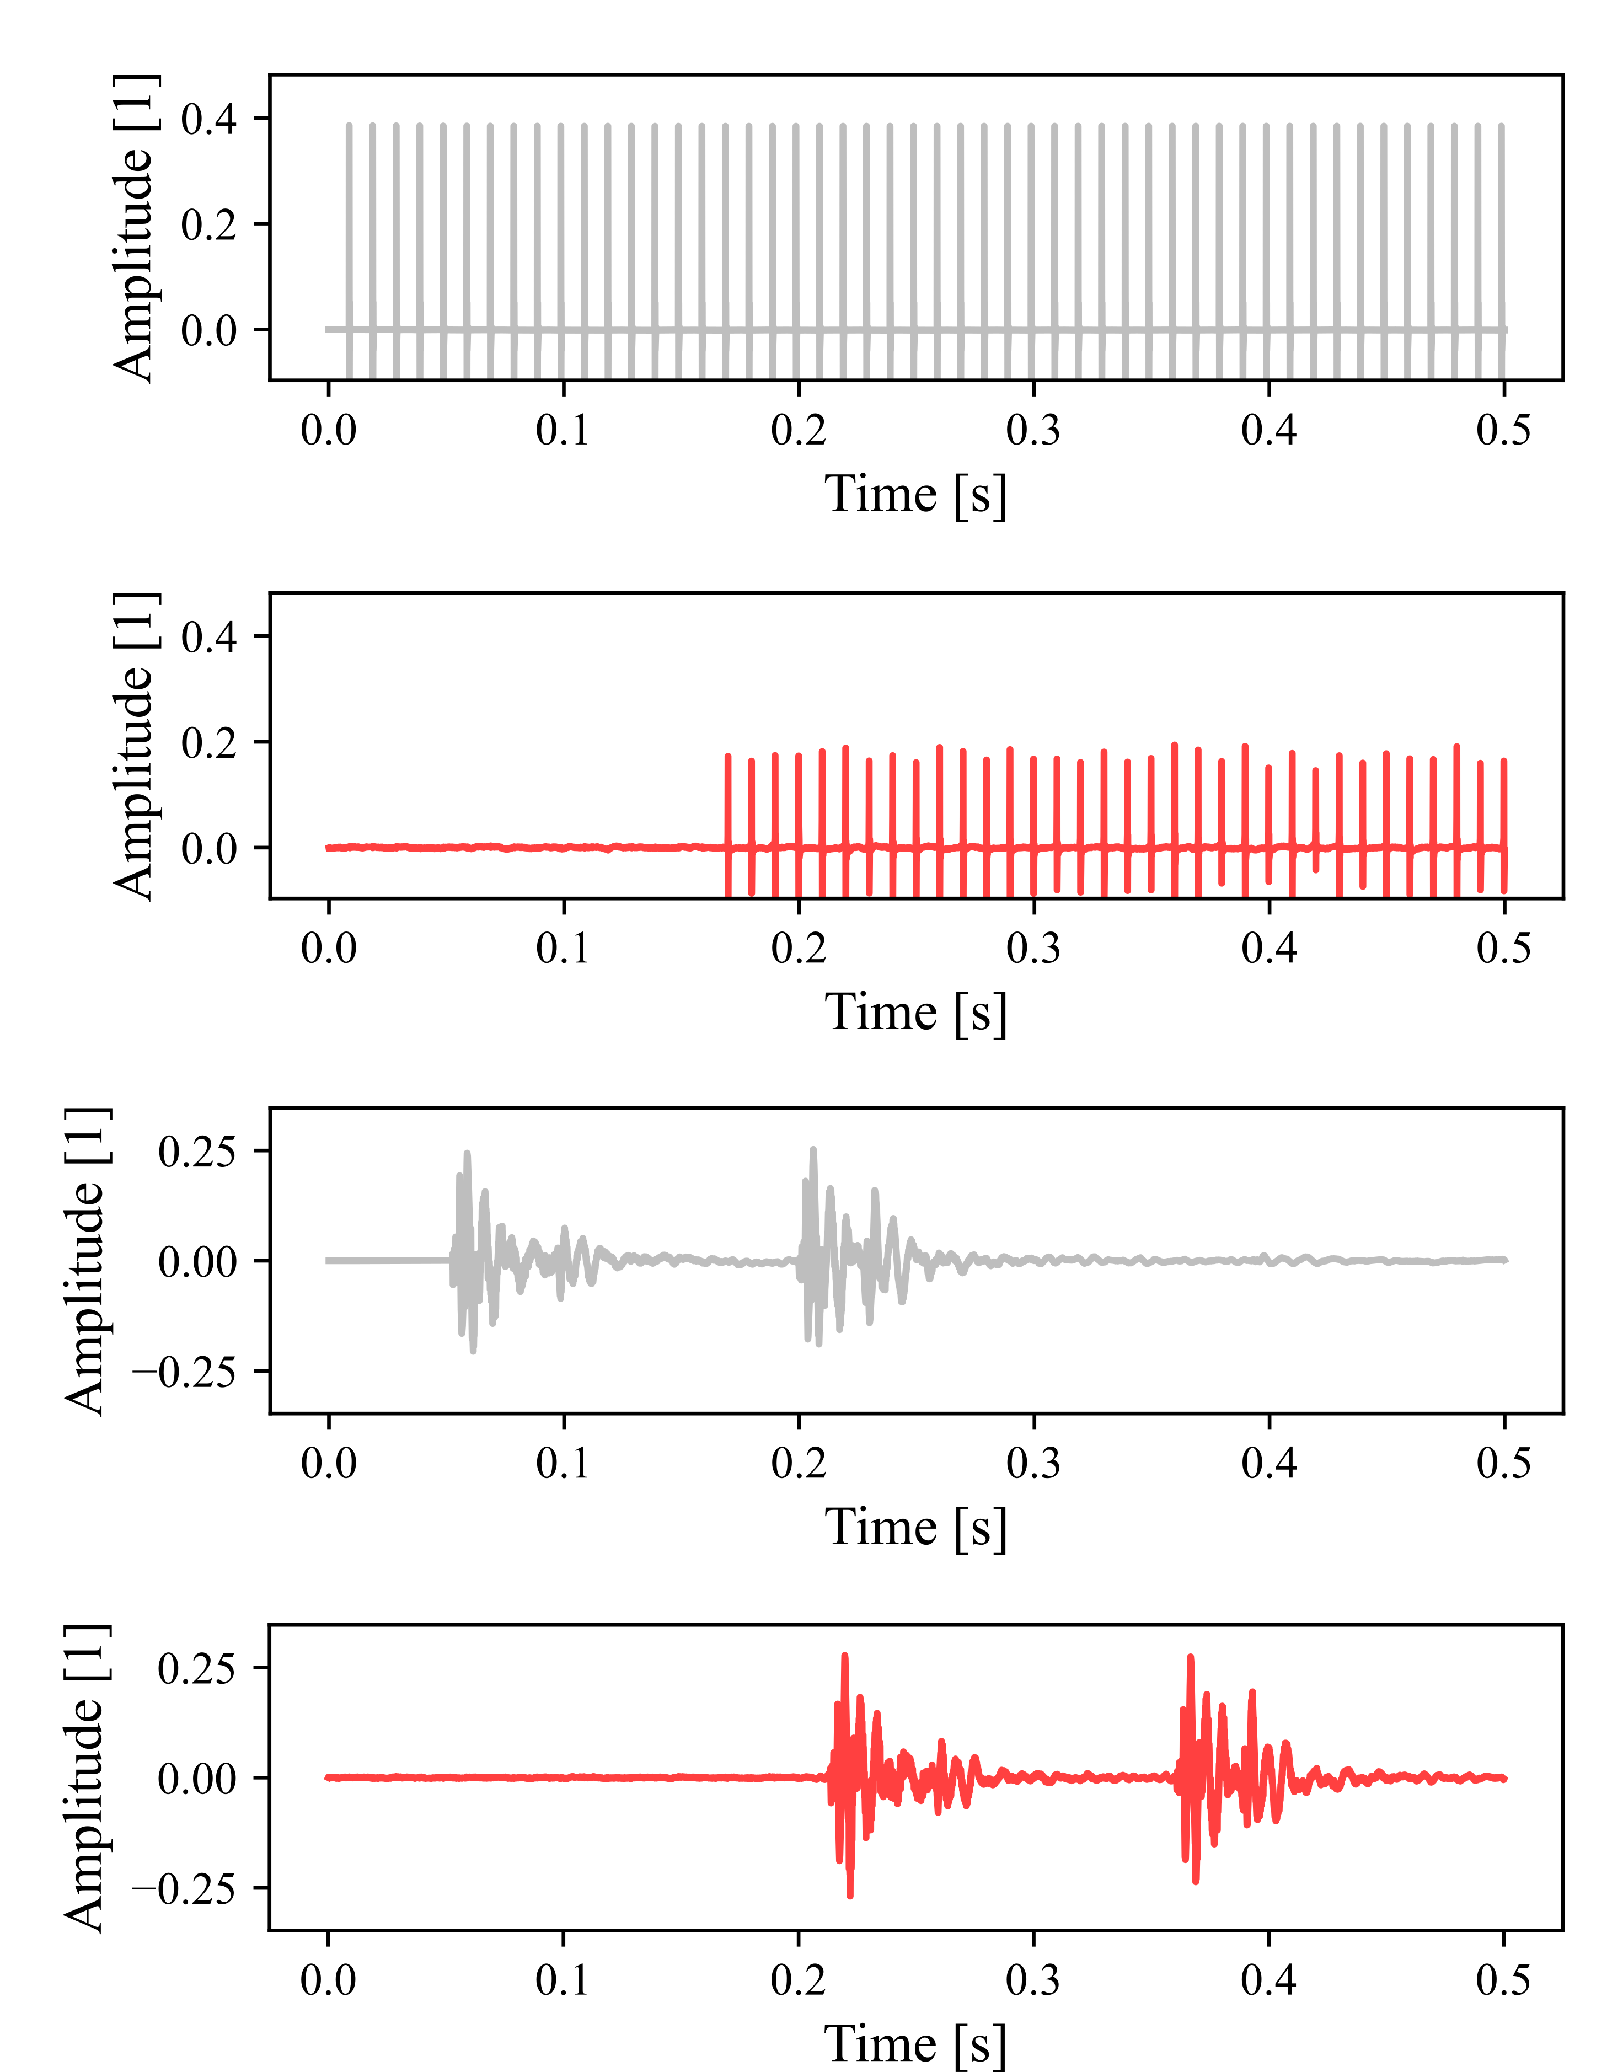
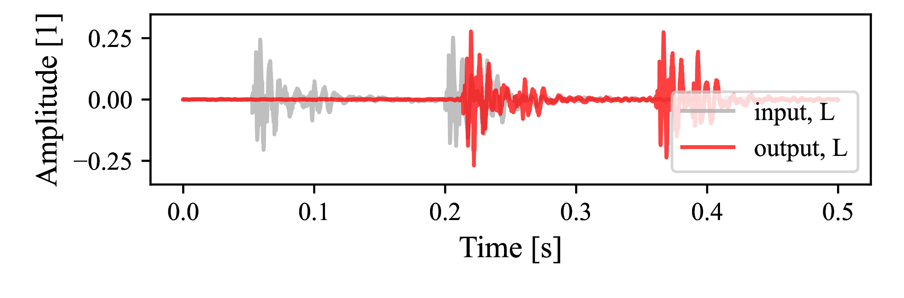
Training The Nonlinearity
Input
Output
Problem: Inputs and outputs are not aligned
Notes:
15sec - 2min45sec

Slide 7
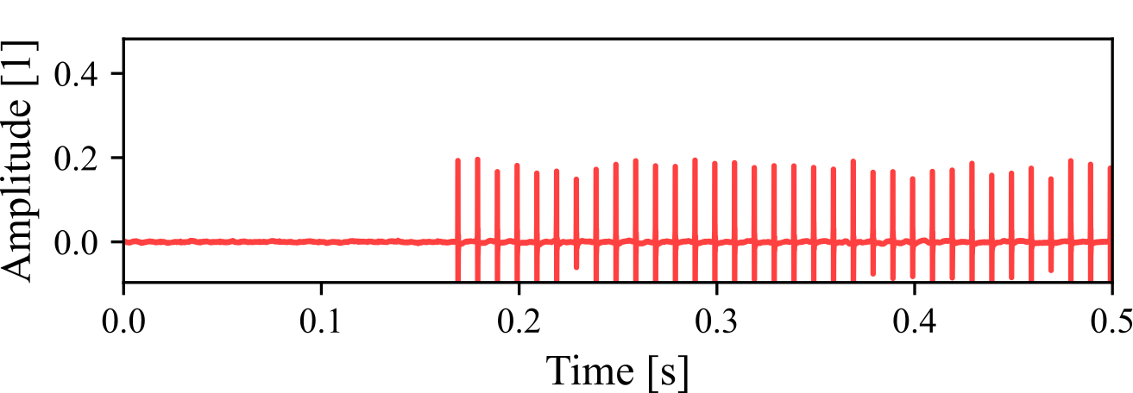
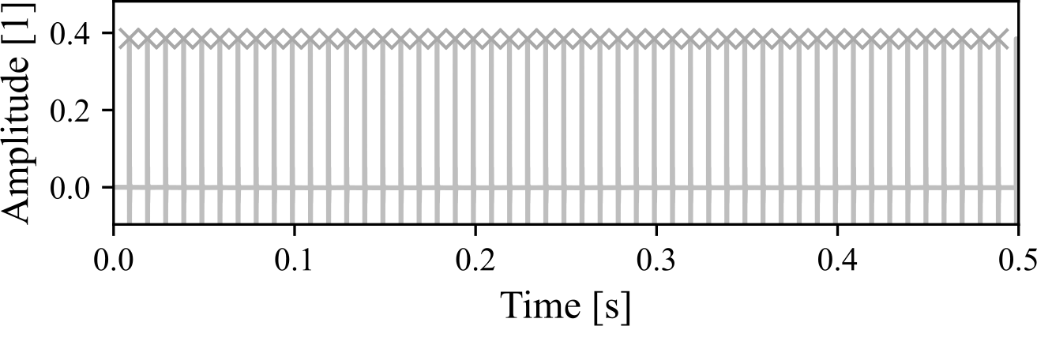
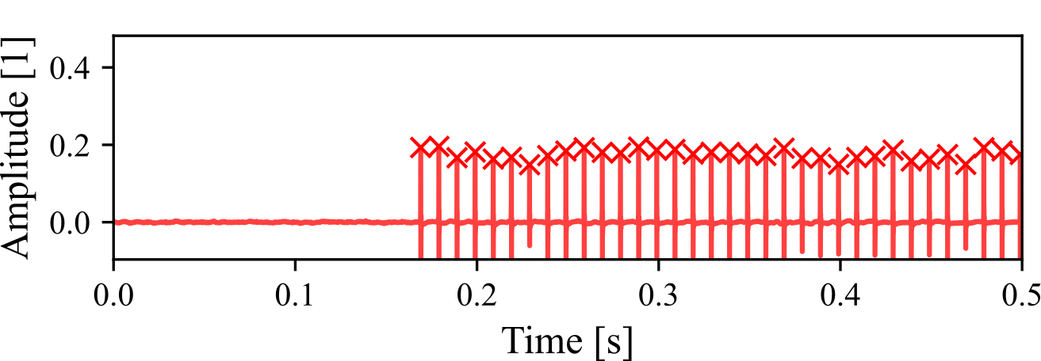
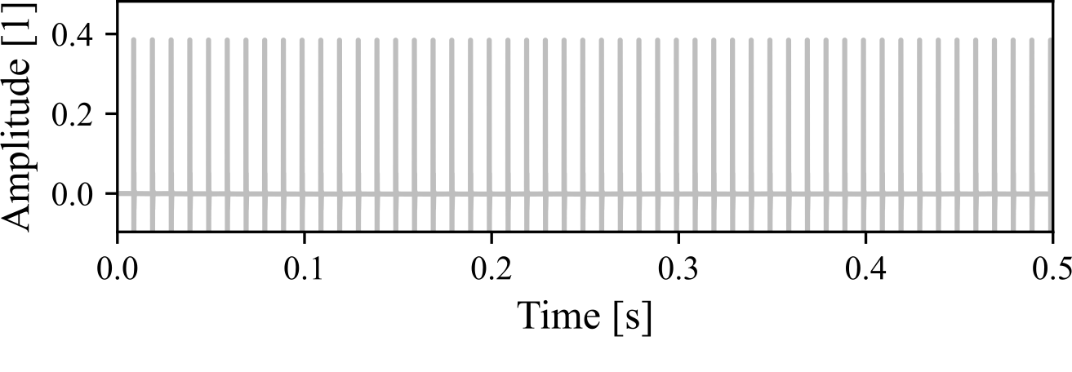
Training The Nonlinearity
Input
Output
Delay Trajectory
Solution: Let’s track some delay trajectories and use them!
Notes:
15sec - 3min

Slide 8
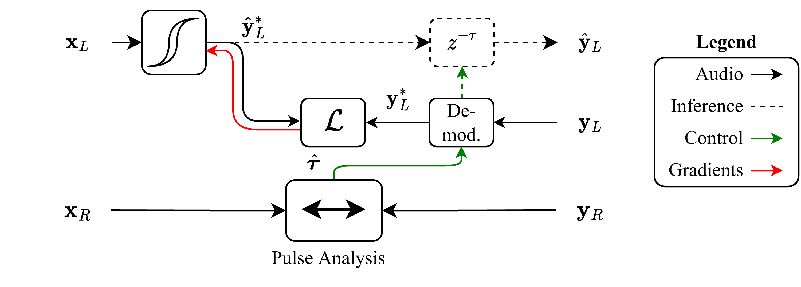
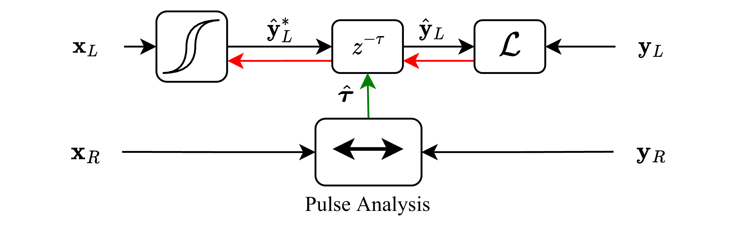
Supervised Schemes
Left
aligned!
Right
”Supervised 1”
”Supervised 2”
Kaloinen. “Neural Modeling of the Audio Tape Echo Effect.”
Masters Thesis, Aalto University, 2022.
Notes:
1min - 4min

Slide 9
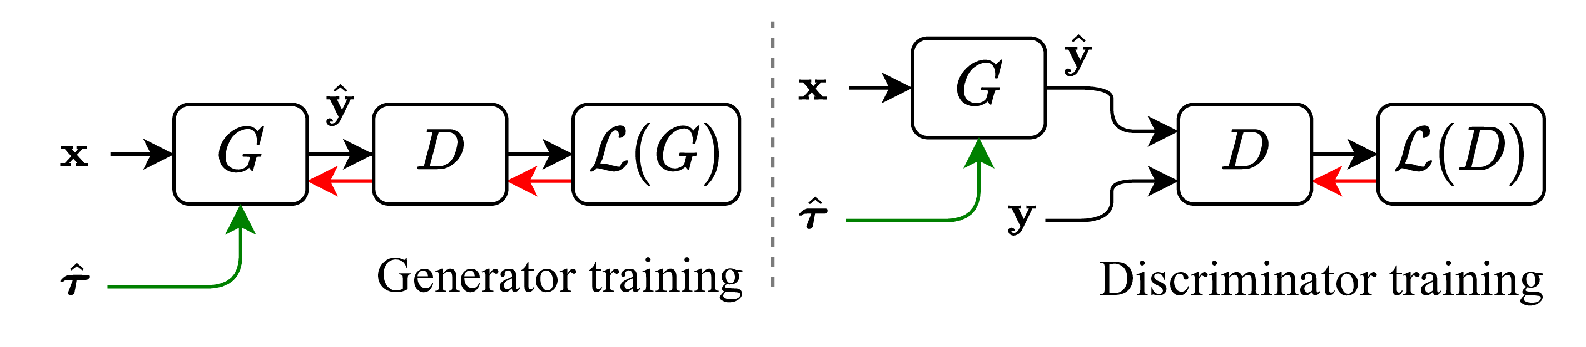
Adversarial Scheme
Mono
unaligned!
Mono
Wright, et al. “Adversarial Guitar Amplifier Modelling with Unpaired Data.”
In Proc. ICASSP. 2023
Notes:
30sec - 4min30sec

Slide 10
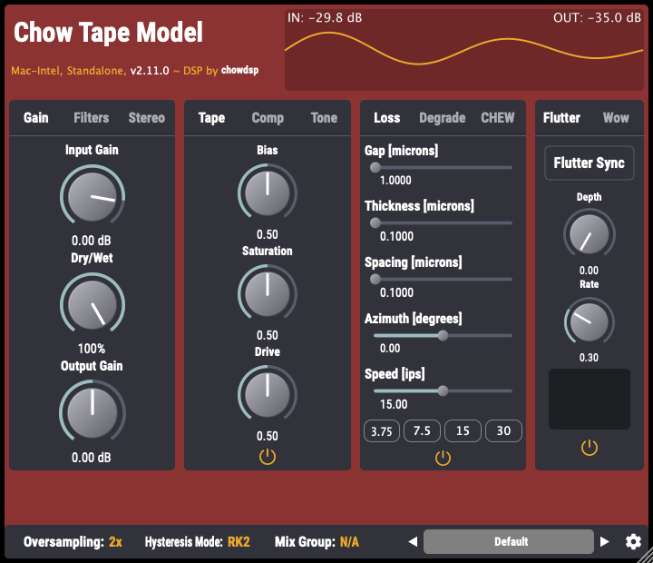

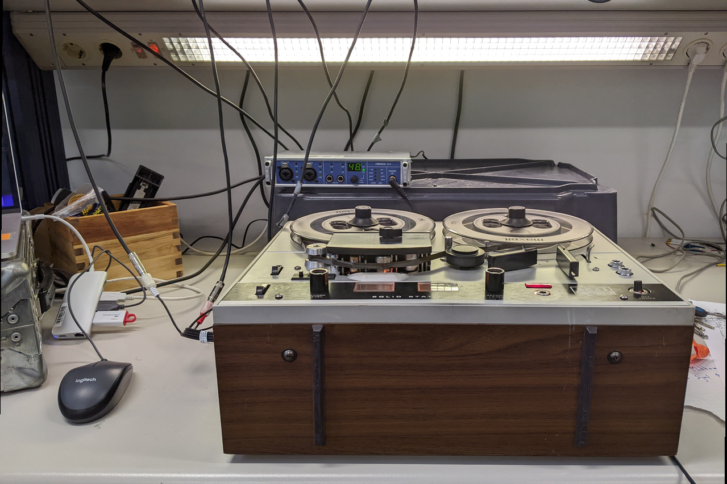
Experimental Setup
Experiment 1 – Toy Data
Python-wrapped CHOWTape
Experiment 2 – Real Data
Akai 4000D reel-to-reel
Input Data
SignalTrain (Hawley et al., 2020)
Pedalboard
© Spotify
CHOWTape
© Chowdhury DSP
Data Collection: Akai 4000D
Notes:
30sec - 5min

Slide 11
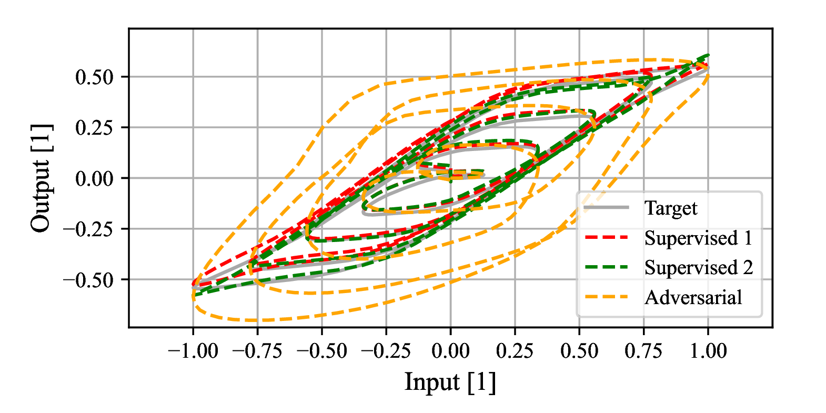
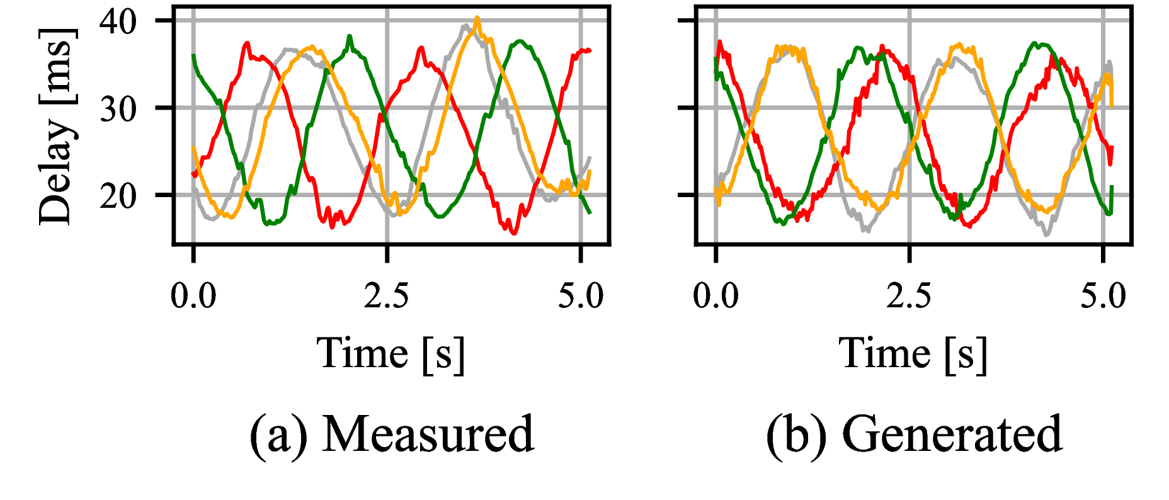
Exp. 1 - Toy Data
Nonlinearity
Delay Trajectories
Outcomes:
RNN learns magnetic hysteresis
Supervised schemes work better than adversarial
Diffusion model captures the delay trajectory distribution
Model:
Real Trajectory
Model:
Generated Traj.
Input
Target
Notes:
1min - 6min

Slide 12
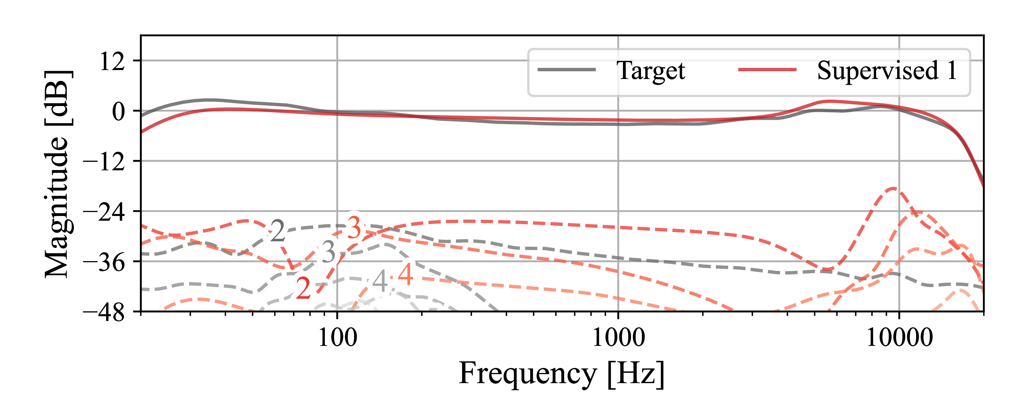
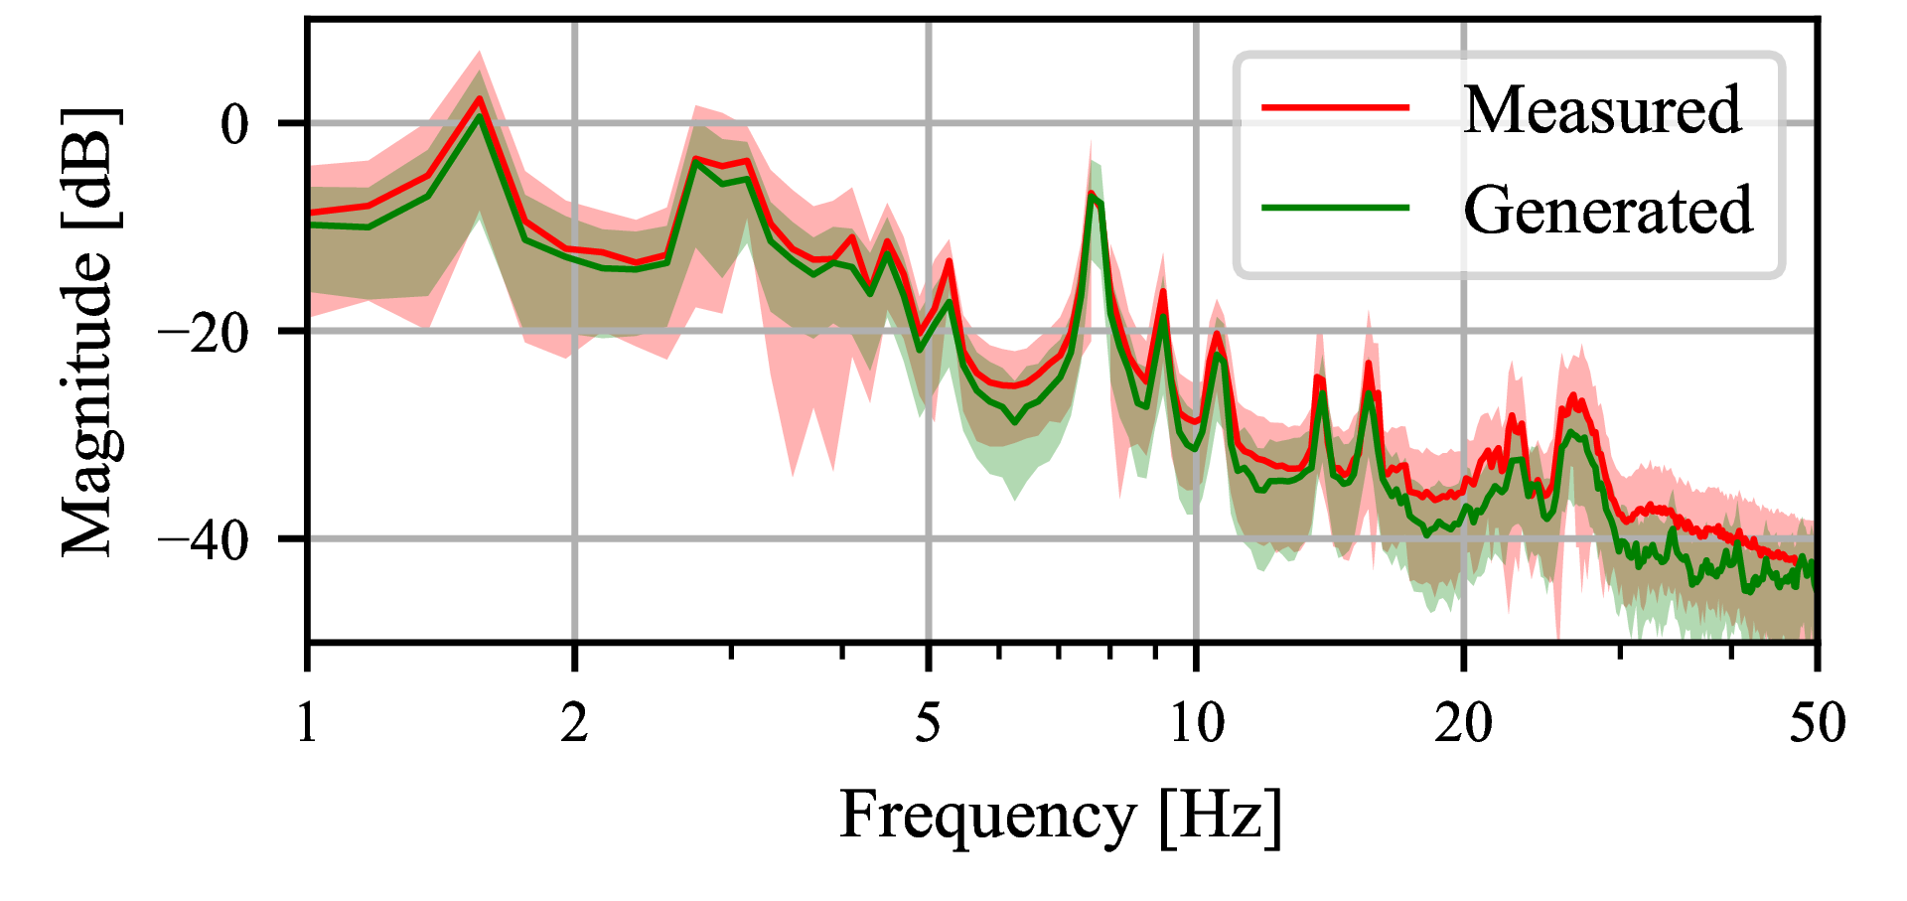
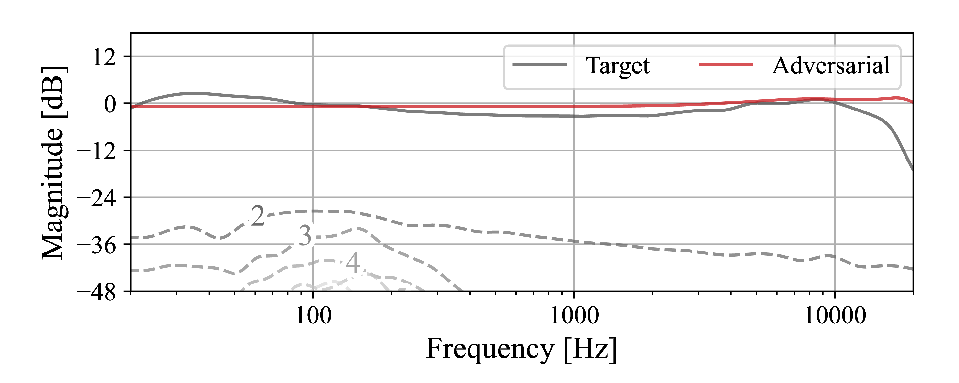
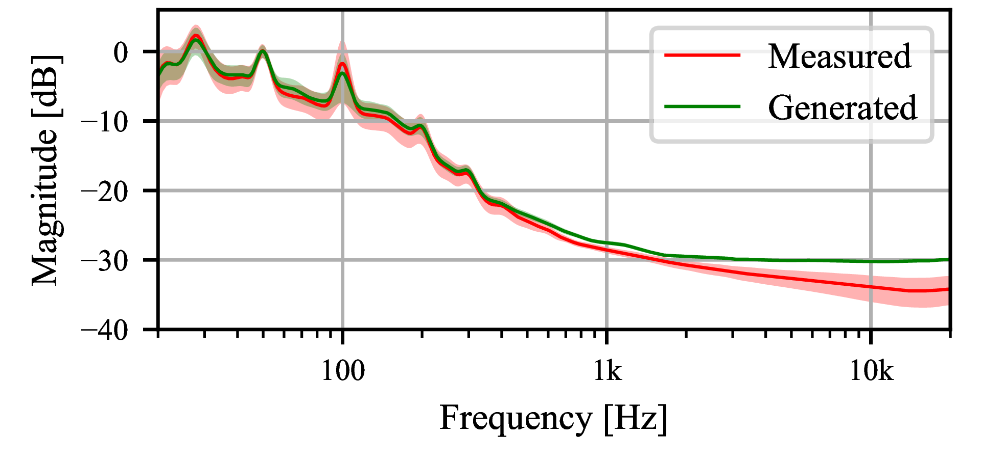
Exp. 2 – Real Data
Input
Target
Model
Supervised 1
Delay Trajectories
Adversarial
Tape Hiss
RNN learns linear response and produces harmonic distortion
Adversarial scheme fails to learn the character
Diffusion model captures delay trajectory and tape hiss distributions
Notes:
1min - 7min

Slide 13
Conclusions
In this work
Grey-box model for VA tape recorders
Training schemes for stereo and mono devices
Delay trajectory and tape hiss generation with diffusion
What do next?
Improve system for monophonic case
Alternative generator architectures?
Notes:
30sec - 7min30sec

Slide 14
I’m looking for work,
come talk to me!
Thanks!
Notes:
8min

